Slide 1
Introduction to Parallel Computing
Adapted from https://computing.llnl.gov/tutorials/parallel_comp/

Slide 2
2-Concepts and Terminology

Slide 3
von Neumann Architecture
Named after the Hungarian mathematician John von Neumann who first authored the general requirements for an electronic computer in his 1945 papers.
Since then, virtually all computers have followed this basic design, which differed from earlier computers programmed through "hard wiring".
Comprised of four main components:
Memory
Control Unit
Arithmetic Logic Unit
Input/Output

Slide 4
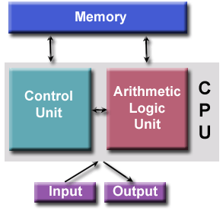

Slide 5
Read/write, random access memory is used to store both program instructions and data
Program instructions are coded data which tell the computer to do something
Data is simply information to be used by the program
Control unit fetches instructions/data from memory, decodes the instructions and thensequentially coordinates operations to accomplish the programmed task.
Aritmetic Unit performs basic arithmetic operations
Input/Output is the interface to the human operator

Slide 6
Flynn's Classical Taxonomy
There are different ways to classify parallel computers. One of the more widely used classifications, in use since 1966, is called Flynn's Taxonomy.
Flynn's taxonomy distinguishes multi-processor computer architectures according to how they can be classified along the two independent dimensions of Instruction and Data. Each of these dimensions can have only one of two possible states: Single or Multiple.

Slide 7
Flynn's Classical Taxonomy
S I S D Single Instruction, Single Data | S I M D Single Instruction, Multiple Data
M I S D Multiple Instruction, Single Data | M I M D Multiple Instruction, Multiple Data

Slide 8
Single Instruction, Single Data (SISD)
A serial (non-parallel) computer
Single instruction: only one instruction stream is being acted on by the CPU during any one clock cycle
Single data: only one data stream is being used as input during any one clock cycle
Deterministic execution
This is the oldest and even today, the most common type of computer
Examples: older generation mainframes, minicomputers and workstations; most modern day PCs.

Slide 9
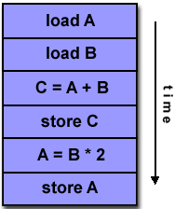
Single Instruction, Single Data (SISD)

Slide 10
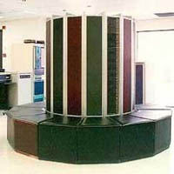

Single Instruction, Single Data (SISD)
CRAY1 Dell Laptop

Slide 11
Single Instruction, Multiple Data (SIMD)
A type of parallel computer
Single instruction: All processing units execute the same instruction at any given clock cycle
Multiple data: Each processing unit can operate on a different data element
Best suited for specialized problems characterized by a high degree of regularity, such as graphics/image processing.

Slide 12
Single Instruction, Multiple Data (SIMD)
Synchronous (lockstep) and deterministic execution
Two varieties: Processor Arrays and Vector Pipelines
Examples:
Processor Arrays: Connection Machine CM-2, MasPar MP-1 & MP-2, ILLIAC IV
Vector Pipelines: IBM 9000, Cray X-MP, Y-MP & C90, Fujitsu VP, NEC SX-2, Hitachi S820, ETA10
Most modern computers, particularly those with graphics processor units (GPUs) employ SIMD instructions and execution units.

Slide 13
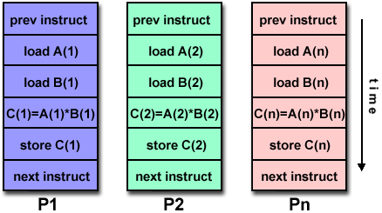
Single Instruction, Multiple Data (SIMD)

Slide 14
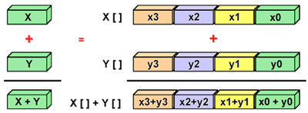
Single Instruction, Multiple Data (SIMD)

Slide 15
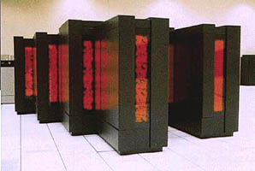
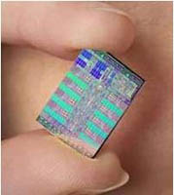
Single Instruction, Multiple Data (SIMD)
Thinking Machines CM-2 Cell Processor (GPU)

Slide 16
Multiple Instruction, Single Data (MISD)
A single data stream is fed into multiple processing units.
Each processing unit operates on the data independently via independent instruction streams.
Few actual examples of this class of parallel computer have ever existed. One is the experimental Carnegie-Mellon C.mmp computer (1971).
Some conceivable uses might be:
multiple frequency filters operating on a single signal stream
multiple cryptography algorithms attempting to crack a single coded message.

Slide 17
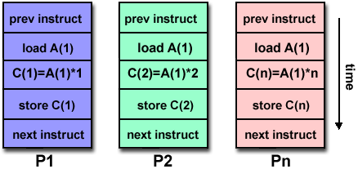
Multiple Instruction, Single Data (MISD)

Slide 18
Multiple Instruction, Multiple Data (MIMD)
Currently, the most common type of parallel computer. Most modern computers fall into this category.
Multiple Instruction: every processor may be executing a different instruction stream
Multiple Data: every processor may be working with a different data stream

Slide 19
Multiple Instruction, Multiple Data (MIMD)
Execution can be synchronous or asynchronous, deterministic or non-deterministic
Examples: most current supercomputers, networked parallel computer clusters and "grids", multi-processor SMP computers, multi-core PCs.
Note: many MIMD architectures also include SIMD execution sub-components

Slide 20
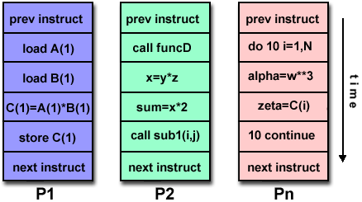
Multiple Instruction, Multiple Data (MIMD)

Slide 21
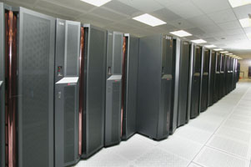
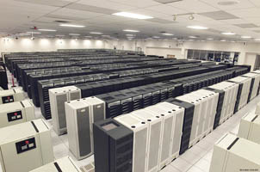
Multiple Instruction, Multiple Data (MIMD)
IBM POWER5 HP/Compaq Alphaserver

Slide 22
Some General Parallel Terminology
Like everything else, parallel computing has its own "jargon". Some of the more commonly used terms associated with parallel computing are listed below. Most of these will be discussed in more detail later.
Task
A logically discrete section of computational work. A task is typically a program or program-like set of instructions that is executed by a processor.
Parallel Task
A task that can be executed by multiple processors safely (yields correct results)
Serial Execution
Execution of a program sequentially, one statement at a time. In the simplest sense, this is what happens on a one processor machine. However, virtually all parallel tasks will have sections of a parallel program that must be executed serially.

Slide 23
Some General Parallel Terminology
Parallel Execution
Execution of a program by more than one task, with each task being able to execute the same or different statement at the same moment in time.
Pipelining
Breaking a task into steps performed by different processor units, with inputs streaming through, much like an assembly line; a type of parallel computing.
Shared Memory
From a strictly hardware point of view, describes a computer architecture where all processors have direct (usually bus based) access to common physical memory. In a programming sense, it describes a model where parallel tasks all have the same "picture" of memory and can directly address and access the same logical memory locations regardless of where the physical memory actually exists.

Slide 24
Some General Parallel Terminology
Symmetric Multi-Processor (SMP)
Hardware architecture where multiple processors share a single address space and access to all resources; shared memory computing.
Distributed Memory
In hardware, refers to network based memory access for physical memory that is not common. As a programming model, tasks can only logically "see" local machine memory and must use communications to access memory on other machines where other tasks are executing.
Communications
Parallel tasks typically need to exchange data. There are several ways this can be accomplished, such as through a shared memory bus or over a network, however the actual event of data exchange is commonly referred to as communications regardless of the method employed.

Slide 25
Some General Parallel Terminology
Synchronization
The coordination of parallel tasks in real time, very often associated with communications. Often implemented by establishing a synchronization point within an application where a task may not proceed further until another task(s) reaches the same or logically equivalent point.Synchronization usually involves waiting by at least one task, and can therefore cause a parallel application's wall clock execution time to increase.
Granularity
In parallel computing, granularity is a qualitative measure of the ratio of computation to communication.
Coarse: relatively large amounts of computational work are done between communication events
Fine: relatively small amounts of computational work are done between communication events

Slide 26
Some General Parallel Terminology
Observed Speedup
Observed speedup of a code which has been parallelized, defined as:
wall-clock time of serial execution ----------------------------------- wall-clock time of parallel execution
One of the simplest and most widely used indicators for a parallel program's performance.
Parallel Overhead
The amount of time required to coordinate parallel tasks, as opposed to doing useful work. Parallel overhead can include factors such as:
Task start-up time
Synchronizations
Data communications
Software overhead imposed by parallel compilers, libraries, tools, operating system, etc.
Task termination time

Slide 27
Some General Parallel Terminology
Massively Parallel
Refers to the hardware that comprises a given parallel system - having many processors. The meaning of "many" keeps increasing, but currently, the largest parallel computers can be comprised of processors numbering in the hundreds of thousands.
Embarrassingly Parallel
Solving many similar, but independent tasks simultaneously; little to no need for coordination between the tasks.
Scalability
Refers to a parallel system's (hardware and/or software) ability to demonstrate a proportionate increase in parallel speedup with the addition of more processors. Factors that contribute to scalability include:
Hardware - particularly memory-cpu bandwidths and network communications
Application algorithm
Parallel overhead related
Characteristics of your specific application and coding

Slide 28
Some General Parallel Terminology
Multi-core Processors
Multiple processors (cores) on a single chip.
Cluster Computing
Use of a combination of commodity units (processors, networks or SMPs) to build a parallel system.
Supercomputing / High Performance Computing
Use of the world's fastest, largest machines to solve large problems.

